Slide 1
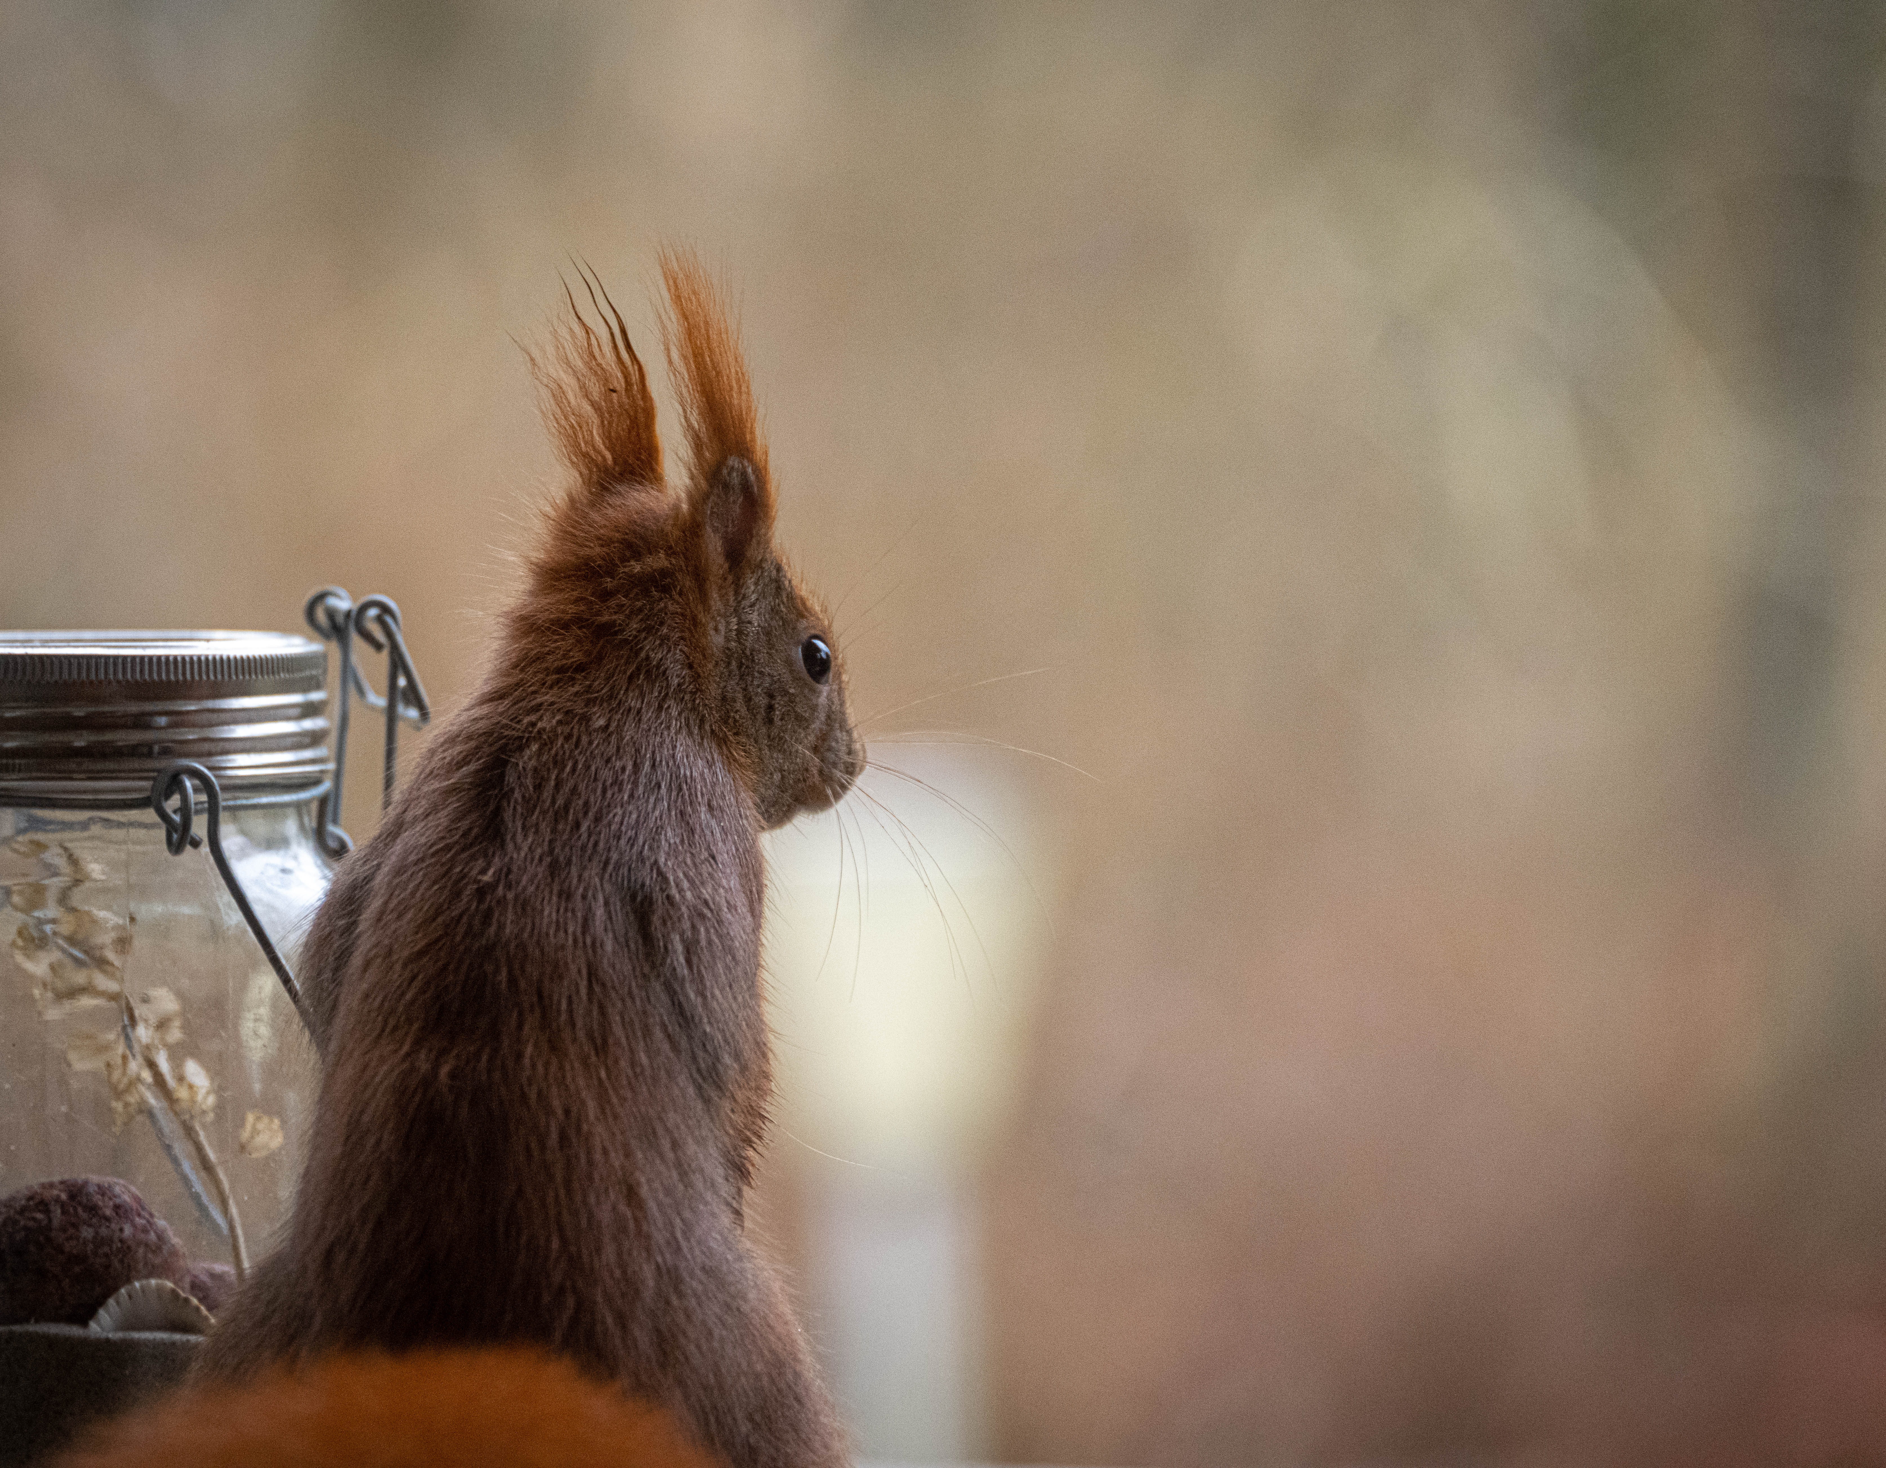
GraphQL Galaxy, online | Dec 8-9 2022 | @nilshartmann
NILS HARTMANN
https://nilshartmann.net
GraphQL
Subscriptions
with Kafka and Debezium
Slides (PDF): https://graphql.schule/galaxy-2022

Slide 2


https://nilshartmann.net
NILS HARTMANN
nils@nilshartmann.net
Software Developer, Architect and Coach from Hamburg
Java, Spring, GraphQL, TypeScript, React
https://graphql.schule/video-kurs
https://reactbuch.de

Slide 3
A simple use-case

Slide 4
A simple use-case

Slide 5
A simple use-case

Slide 6
A simple use-case 🤔

Slide 7
A simple use-case 🤔

Slide 8
A simple use-case 🤔

Slide 9
A simple use-case 🤔

Slide 10
A simple use-case 🤔

Slide 11
A simple use-case 🤔
😊
😢

Slide 12
Message Broker

Slide 13
Message Broker

Slide 14
Message Broker

Slide 15
Message Broker

Slide 16
Message Broker
😊
😊

Slide 17
Adding a database...

Slide 18
Adding a database...

Slide 19
Adding a database...

Slide 20
😢
😢
Adding a database...

Slide 21
Adding a database...

Slide 22
😢
😢
Adding a database...

Slide 23
Change Data Capture (CDC)
Debeziun

Slide 24
Debezium – https://debezium.io

Slide 25
Debezium – https://debezium.io
Debezium
Change Event
{
source: { table: "customers" },
}

Slide 26
Debezium – https://debezium.io
Debezium
Change Event
{
source: { table: "customers" },
op: "update",
}

Slide 27
Debezium – https://debezium.io
Debezium
Change Event
{
source: { table: "customers" },
op: "update",
before: {
id: 1000,
name: "Heinz",
address: "Somewhere 123"
},
after: {
id: 1000,
name: "Clara",
address: "Mainroad 47"
}
}

Slide 28
Debezium
😊
😊

Slide 29
Debezium
😊
😊

Slide 30
Debezium
😊
😊

Slide 31
Debezium
😊
😊

Slide 32
Debezium
😊
😊

Slide 33
Debezium
😊
😊
Guaranteed delivery
Guaranteed delivery
Guaranteed delivery

Slide 34
Try out
😊
😊
with graphql-java and Spring for GraphQL
https://graphql.schule/galaxy-example

Slide 35
What's next?
"Read model" database for GraphQL API 🤔

Slide 36
What's next?
"Read model" database for GraphQL API 🤔

Slide 37

HTTPS://NILSHARTMANN.NET | @nilshartmann
Thanks a lot!
Slides: https://graphql.schule/galaxy-2022 (PDF)
Source-Code: https://graphql.schule/galaxy-example
Contact: nils@nilshartmann.net

